Slide 1

BRITISH AIRWAYS
Prediction of customer buying behavior

Slide 2
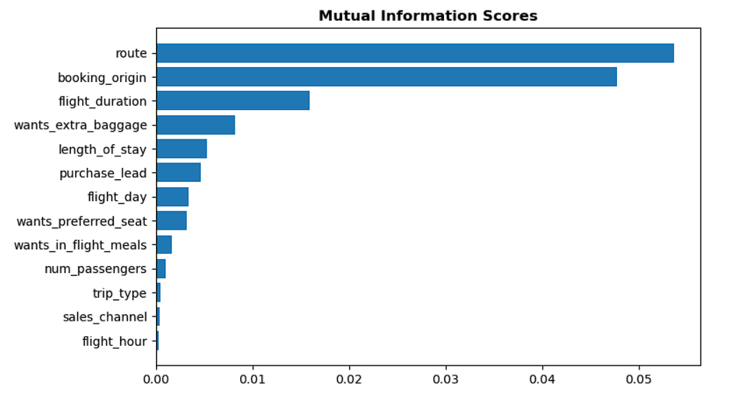
A predictive model for analyzing the factors that shapes buying behavior
The dataset was trained using a random forest classifier, and the results were received:
Accuracy: 85.37
AUC Score: 0.567
Five key features impacting customer buying behavior :
1. route
2. booking_origin
3. flight_duration
4. wants_extra_baggage
5. length_of_stay

